Slide 1

Presentation on
Chronic kidney disease detection using machine learning
of
Bachelor Of Technology
in
Computer Science and Engineering(Data Science)
By
P. Arvind (20K91A6734) P.Laxmi Priya (20K91A6731)
M.Sai (20K91A6726) K.Sai Ram (21K95A6704)
Under the esteemed guidance of
MRS.K.KIRANMAYEE (Asst. Prof.)

Slide 2
INTRODUCTION
Chronic Kidney Disease [CKD] is a condition that affects the kidneys and reduces their ability to filter waste and excess fluid from the blood.
Chronic Kidney Disease is a severe lifelong condition caused by diabetes, high blood pressure, and by Renal disease.
Project aims to develop a predictive model or system that can accurately and early detect the presence of disease in individuals.

Slide 3
ABSTRACT
Project initiates and provide a valuable tool for early detection and risk assessment, ultimately leading to better pateint outcomes and reduced health care costs .
We explore the application of various machine learning algorithms to predict the levels of chronic diseases and recommend appropriate drugs based on patient profiles.
Early prediction based on patient conditions and physical symptoms which results in accurate reports.The goal is to improve accuracy , optimise treatment plans , and enhance patient outcomes.

Slide 4
PROBLEM STATEMENT
The problem we identified in existing approaches is they are primarily targeting patients at advanced stages ( 3 and 4) , neglecting those in the crucial early stages (1 and 2) .
Most commonly used technique for kidney functioning is GFR ( Glomerular Filtration Rate) is not sufficient to diagnose CKD.
Didn't identify the most important attributes needed to improve diagnosis.
The accuracy is not effective.
Delayed interventions and compromised health outcomes.

Slide 5
EXISTING SYSTEM
The current approach to CKD prediction is done by using computer-aided diagnosis which reduce diagnosis costs and improve patient management and outcomes.
Automated sensing of CKD using deep learning system based on monitoring of salivary urea concentration.
Prediction of CKD using machine learning classifier algorithms such as ANN, SVM , LR, RF etc...
Integrated model which combines ML algorithms to achieve an higher accuracy for complicated clinical data

Slide 6
PROPOSED SYSTEM
Our proposed system levarages advanced ML algorithms to enhance chronic disease detection and prediction accuracy.
We formulate a multi-class classification task to predict disease levels [eg : high , medium, low ].
We also introduce drug recommendation system for the people who affected with the kidney related diseases.
We also predict price for those drugs we recommend in a suitable way.

Slide 7
OBJECTIVE
The primary objective of this project is to develop a machine learning-based system for the early detection and accurate diagnosis of chronic kidney disease (CKD). By leveraging machine learning algorithms and techniques, we aim to create a reliable tool that assists healthcare professionals in identifying CKD in patients at an early stage, enabling timely intervention and improving overall patient outcomes.
Disease Identification
Early Detection
Multiclass Classification
High Accuracy
Real-Time Processing.

Slide 8
LITERATURE SURVEY
S.NO | AUTHOR | WEBSITE LINKS | ABSTRACT | CONCLUSION
1 | 2021 Md. Rashed-Al-Mahfuz;Abedul Haque;Akm Azad;Salem A. Alyami;Julian M. W. Quinn;Mohammad Ali Moni | https://ieeexplore.ieee.org/document/9405681 | TITLE:Clinically Applicable Machine Learning Approaches to Identify Attributes of Chronic Kidney Disease (CKD) for Use in Low-Cost Diagnostic Screening Chronic kidney disease (CKD) is a major public health concern worldwide. High costs of late-stage diagnosis and insufficient testing facilities can contribute to high morbidity and mortality rates in CKD patients, particularly in less developed countries. | This paper has identified a reliable method for CKD classification and cost effectiveness. It also found that an RF classifier method provides significantly high classification accuracy with the pathologically categorized attributes sets .

Slide 9
S.NO | YEAR AND AUTHOR | WEBSITE LINK | ABSTRACT | CONCLUSION
2 | 2020 Guozhen Chen; Chenguang Ding; | https://ieeexplore.ieee.org/document/9094581 | TITLE:Prediction of Chronic Kidney Disease Using Adaptive Hybridized Deep Convolutional Neural Network on the Internet of Medical Things Platform. In the present area of research, Kidney cancer is one of the deadliest and crucial importance for the survival of the patients ’ diagnosis and classification. Early diagnosis and proper therapy can stop or delay the development of this chronic disease into the final stage | This paper presents the adpative hybridized deep convolutional neural network (AHDCNN) for early prediction and diagnosis of CKD.
3. | 2019 Navenneth Bhaskar, Suchatha M. | https://ieeexplore.ieee.org/document/8843936 | TITLE:A Deep-Learning-Based System for Automated Sensing of Chronic Kidney Disease. we propose a new sensing technique for the automated detection of kidney disease. The salivary urea concentration is monitored to detect the disease. A new sensing approach is introduced to monitor the urea levels in the saliva sample. | The raw sensor signal is directly given to the deep learning algorithm for predictive decision making.

Slide 10
S.NO | YEAR AND AUTHOR | WEBSITE LINK | ABSTRACT | CONCLUSION
4. | 2020 Jiongming qin, Lin Chen | https://ieeexplore.ieee.org/document/9333572 | TITLE: A Machine Learning Methodology for Diagnosing Chronic Kidney Disease. Chronic kidney disease (CKD) is a global health problem with high morbidity and mortality rate, and it induces other diseases. Since there are no obvious symptoms during the early stages of CKD, patients often fail to notice the disease. Early detection of CKD enables patients to receive timely treatment to ameliorate the progression of this disease. | The proposed CKD diagnostic methodology is fesible in terms of data imputation and sample daignosis.
5. | 2022 Chilakamarthi Prem Kashyap;Gollapudi Sai Dayakar Reddy;M Balamurugan | https://ieeexplore.ieee.org/document/10040329 | TITLE:Prediction of Chronic Disease in Kidneys Using Machine Learning Classifiers chronic kidney disease (CKD) is a diagnosis that occurred in kidney which is also called as chronic renal disease. Chronic Kidney Disease means that if a person is suffering from CKD, then that person's kidney is not functioning properly since itcould be damaged and cannot purify the blood as like the normal kidney. | In this paper we have used four machine learning algorithms which are Support vector machine classifier (SVM), K-Nearest Neighbor algorithm (KNN), Random Forest algorithm and lastly decision tree algorithm.

Slide 11
S.NO​ | YEAR AND AUTHOR​ | WEBSITE LINK​ | ABSTRACT​ | CONCLUSION​
6. | 2023 Arvind Sharma | https://ieeexplore.ieee.org/document/9333572​ | TITLE: A Statistical Review on Machine Learning Based Medical Diagnostic Systems for Chronic Kidney Disease ​The decision making is a very challenging and complex process while doing the diagnosis of any specific illness. Huge ambiguities and problems are faced in the process of diagnosing by using the human visual system, which leads to conclusions that are inappropriate and unsuitable for a chronic kidney disease diagnosis. ​ | The primary focus of this study is to statistically review the various proposed and developed medical diagnostic systems for the diagnosis of chronic kidney disease using machine learning algorithms.
7. | 2022​ Chilakamarthi Prem Kashyap;Gollapudi Sai Dayakar Reddy;M Balamurugan​ ​ ​ | https://ieeexplore.ieee.org/document/10040329​ | TITLE:An Intelligent Clinical Support System For The Early Diagnosis Of The Chronic Kidney Disease Chronic kidney disease is a fatal renal illness, affecting a huge percentage of the world's population. This disease is life-threatening, possessing high morbidity and mortality rates. This disease being asymptomatic even at higher stages, its early diagnosis is of vital importance. ​ | The SVM model proposed in this system reported accuracy of 99.17%. The usefulness of such a system lies in the mitigation of human loss that can be achieved by an accurate diagnosis of this renal ailment.

Slide 12
LITERATURE SURVEY CONCLUSION
These papers presents the adpative hybridized deep convolutional neural network (AHDCNN) for early prediction and diagnosis of CKD.But they are unable to detect disease in the early stages like at stage 0 and stage 1.
identified a reliable method for CKD classification and cost effectiveness but it does not give the highest accuracy . Some of the Machine Learning algorithms are not at all suitable for the early detection and good accuracy.
CKD diagnostic methodology is fesible in terms of data imputation and sample daignosis. They does not identify important attributes and explain about the correlations.
The raw sensor signal is directly given to the deep learning algorithm for predictive decision making. But it is cost effective and produces delayed interventions.

Slide 13
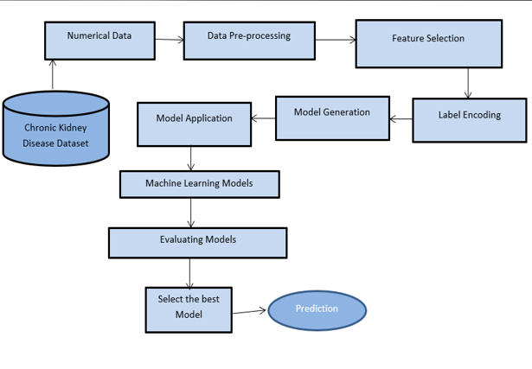
ARCHITECTURE DIAGRAM

Slide 14
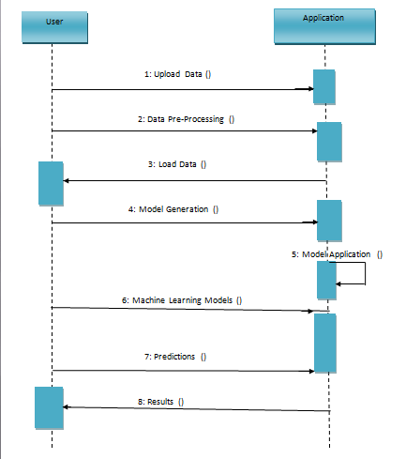
SEQUENCE DIAGRAM

Slide 15
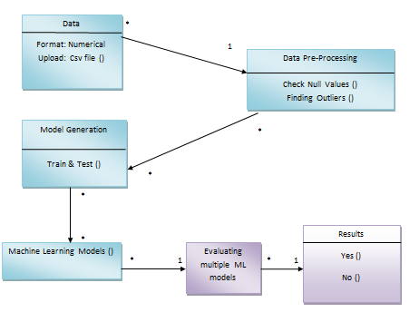
USE CASE DIAGRAM

Slide 16
MODULES
USER LOGIN
User credentials
New user
ADMIN LOGIN
Admin Credentials
User access
DISEASE DETECTION
Stage of the disease
MULTI CLASS CLASSIFICATION

Slide 17

SCREENSHOTS

Slide 18


Slide 19
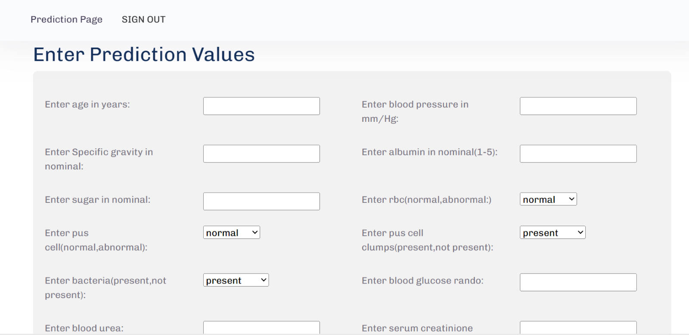

Slide 20


Slide 21
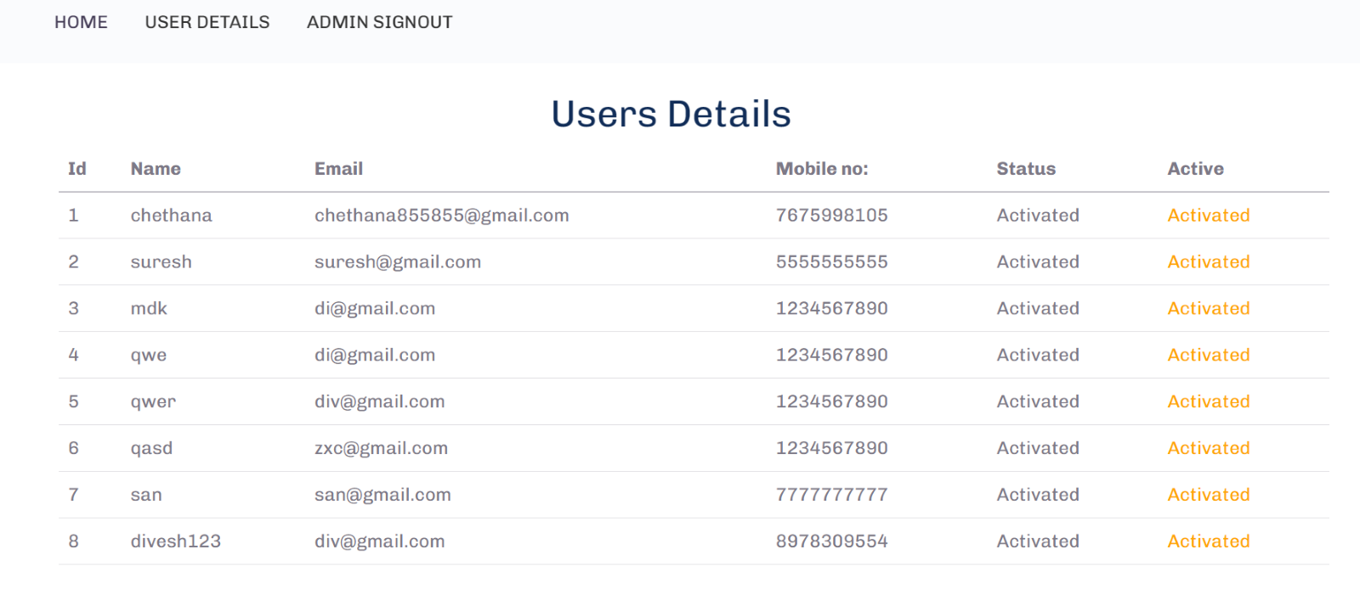

Slide 22
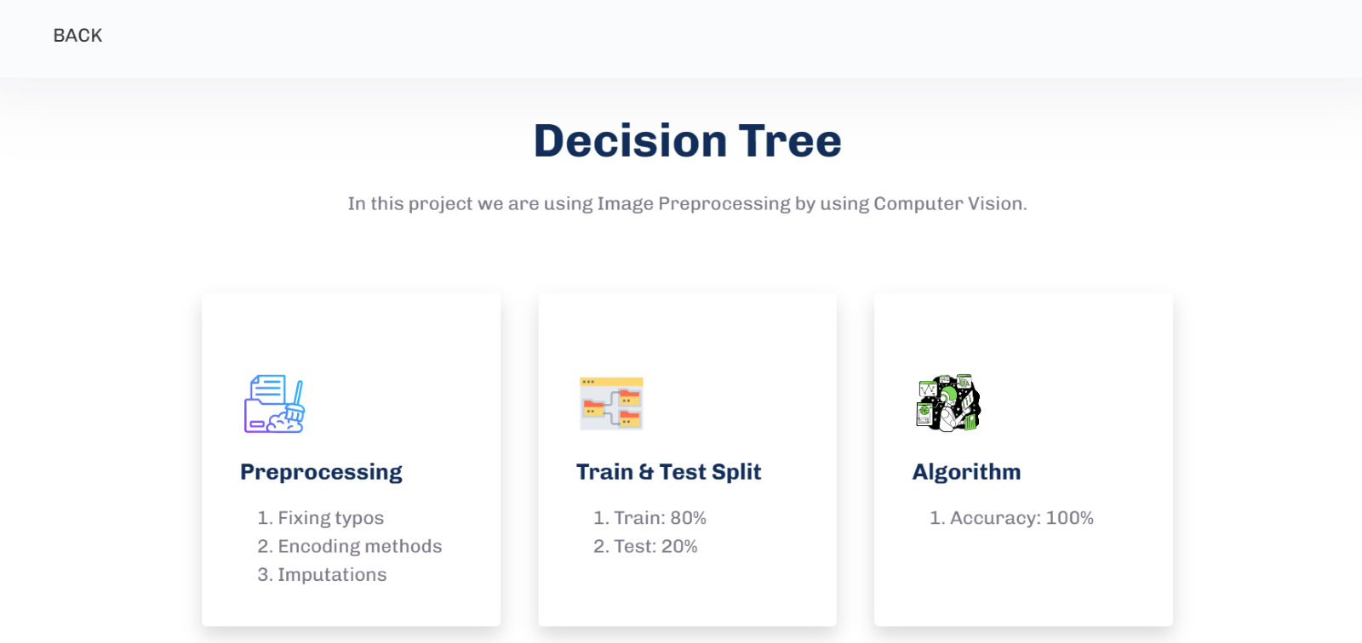

Slide 23


Slide 24
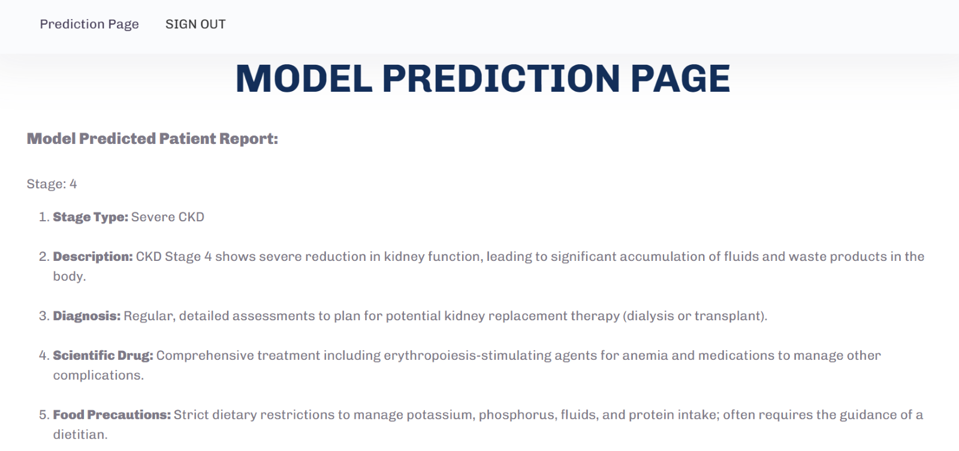

Slide 25
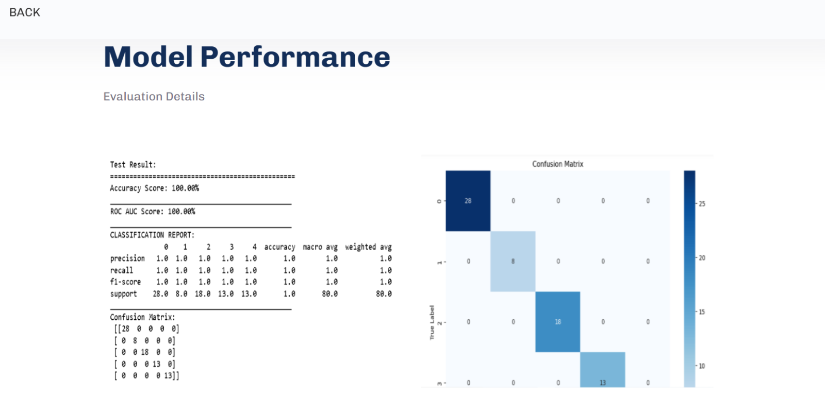

Slide 26
FUTURE SCOPE
Detecting chronic kidney disease (CKD) holds promise for significant future development and impact. Firstly, ongoing research can refine CKD detection algorithms to improve diagnostic accuracy by integrating machine learning techniques with medical imaging, genetic data, or other diagnostic modalities. Secondly, efforts can focus on early detection and prevention, employing predictive models to identify individuals at high risk and allowing for timely interventions to slow disease progression. . Overall, the future scope of CKD detection projects encompasses various areas of research, technology development, and healthcare delivery, with the potential to make a significant impact on public health.

Slide 27
METHODOLOGY
Data Collection and Preprocessing:
Feature Engineering:
Dataset Splitting
Model Selection and Development
Model Training and Evaluation
Model Optimization and Fine-Tuning

Slide 28
TESTING
Integration Testing: Verify that the deployed model integrates seamlessly with the existing infrastructure, such as databases, APIs, or front-end applications.
Scalability Testing: Assess the performance of the model under varying loads to ensure scalability. This involves testing the model's response time and resource consumption as the number of requests increases.
Model Input Validation: Validate the input data to ensure that it meets the expected format and range. Implement checks to handle missing values, outliers, or unexpected inputs gracefully.
Model Output Verification: Validate the output of the model against expected results or ground truth labels. Compare model predictions with actual outcomes to ensure accuracy.
Error Handling: Implement robust error handling mechanisms to gracefully handle errors and exceptions that may occur during model inference. Provide informative error messages for easier debugging.
Security Testing: Assess the security of the deployed model to identify and mitigate potential vulnerabilities, such as input validation bypasses, injection attacks, or unauthorized access to sensitive data.

Slide 29
TECHNOLOGY SPECIFICATIONS
Hardware Specifications:
Processer : Intel i3 or above
Hard disk : 120GB
Ram : 4GB or higher
Software Specifications:
OS : Windows 8 or above
Programming : Python 3.7 or above
Python IDE : Jupiter notebook
Local System : Anaconda installation with necessary libraries installations
Cloud : Google Colab

Slide 30
CONCLUSION
In conclusion, the project has illuminated the potential of machine learning in transforming the landscape of CKD Detection.
By focusing on early stage diagnosis we can address a critical gap in healthcare.
This work represents a blueprint for the future of healthcare.
By providing the drug needed for the patients, makes them easier to get rid of it.

Slide 31
THANK YOU !

